Slide 1
SURROGATE CITY FINDER TOOL
SSAD_TEAM 46
RELEASE 1
A web application to work with weather data files and match cities with similar climates.

Slide 2
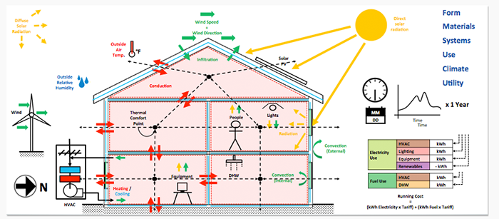
WHY DO WE NEED THE APP?
Building Thermal Performance Analysis

Slide 3
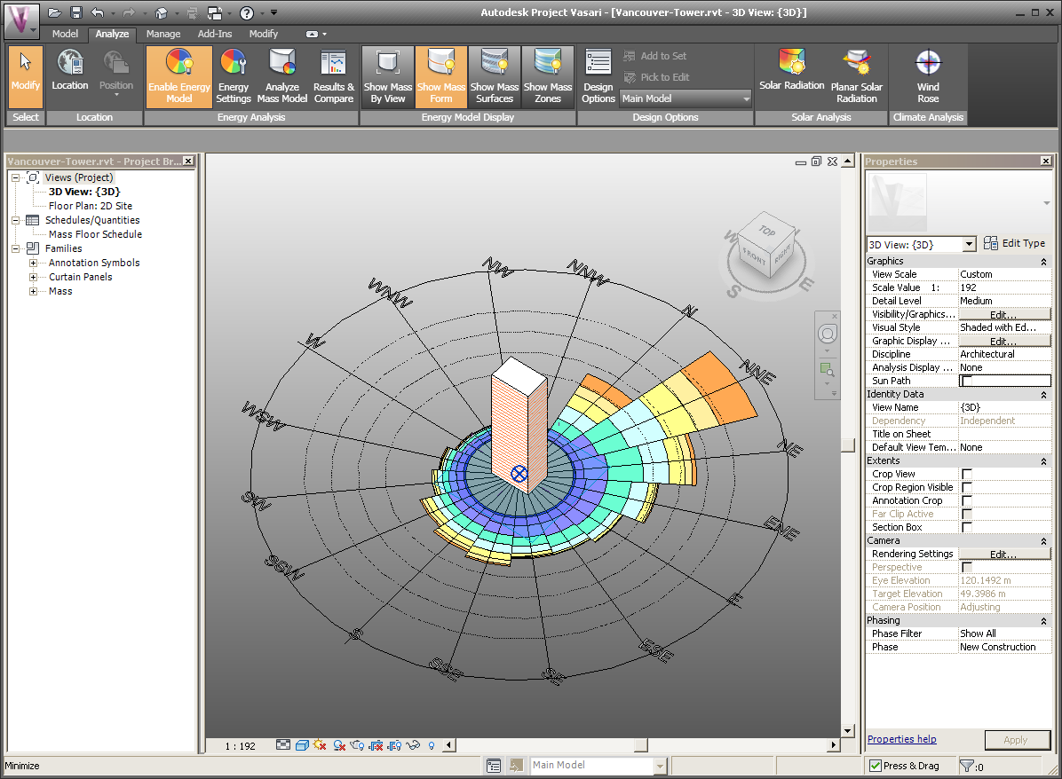
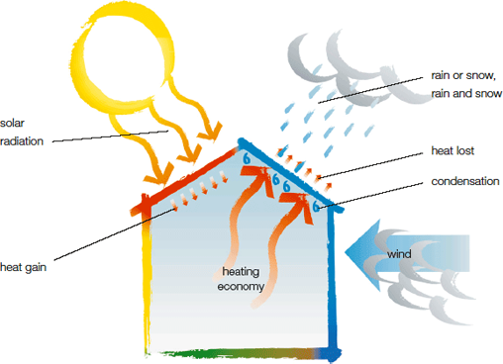
WHY DO WE NEED THE APP?
Construction Of Green Buildings

Slide 4
WEATHER DATA FILES
File Format: .epw
Source: http://apps1.eere.energy.gov/buildings/energyplus/weatherdata_about.cfm
Contain extensively detailed information about weather data of a particular city
Exists for 15,000 locations throughout the world 67 in India
Used for Weather Simulations

Slide 5
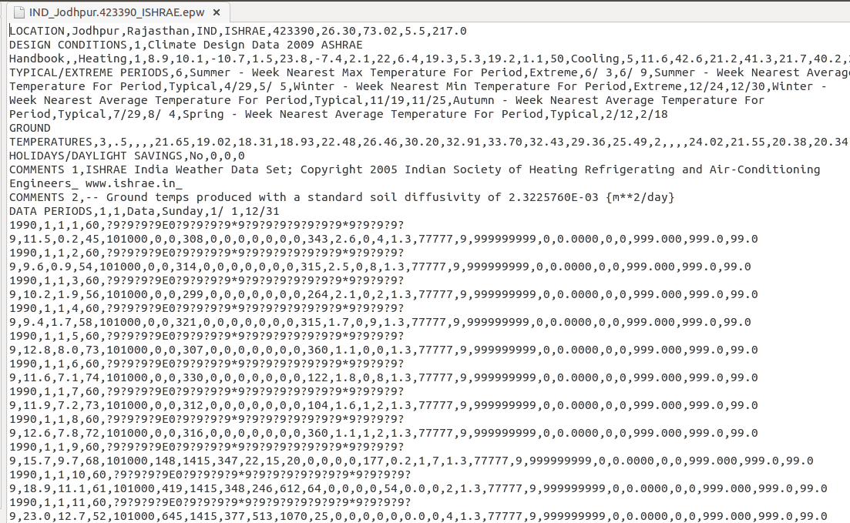
Sample Weather Data File

Slide 6
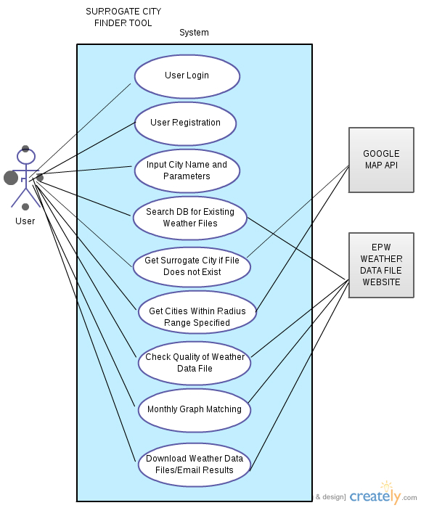
Requirements
USE CASES IMPLEMENTED IN R1:
User Login
User Registration
Input City Name And Parameters
Search DB for Existing files
Get Surrogate Cities if file does not exist.
Get Cities within Radius Range Specified

Slide 7
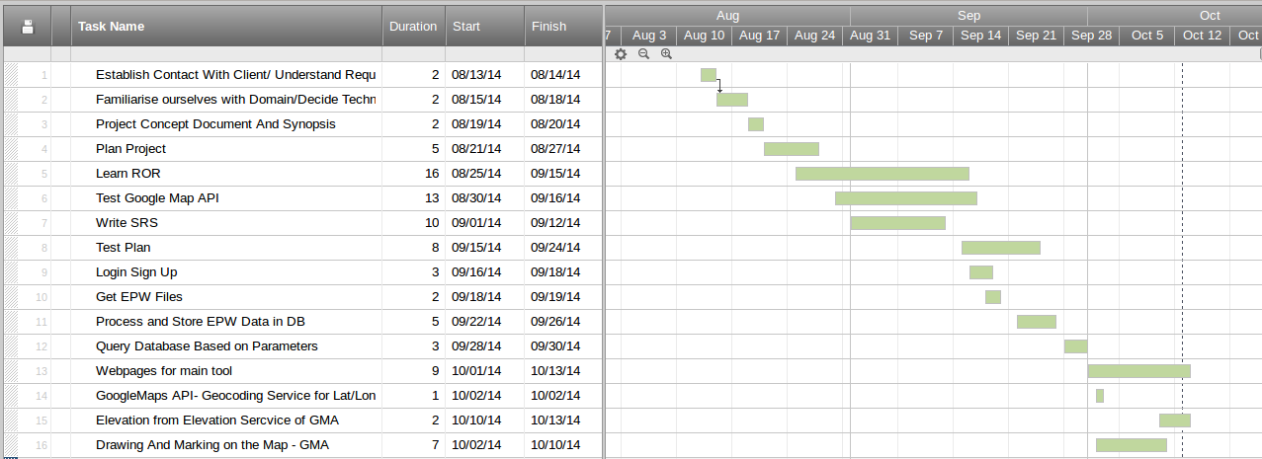
Project Timeline
Bullets go in here
And also in here

Slide 8
PLAN FOR R2
Check quality of weather data files
Download Weather Data Files/Email Results
Monthly Graph Matching
Improve UI

